Slide 1
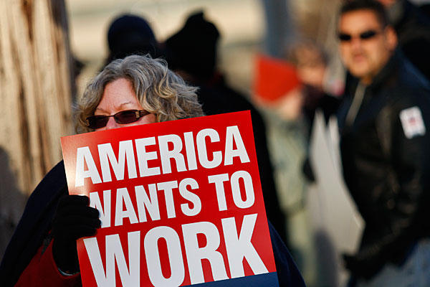
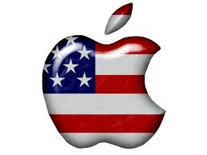
Work, Exchange, and Technology
Alison A, Ashley A, Chris B, Devin F, Melody H, Matt S

Slide 2
Theme Statement
The gradual movement from the US being in the industrial sector to the service sector is due to the rise of the internet, US financial power, and the new jobs these changes brought.

Slide 3
Trends
Globalization
As America became service and financially driven in world affairs, America become more reliant on other countries.
Change to the financial sector
America became more economically fragile and service driven due to the decrease in manufacturing.
Rise of technology
Developing technologies brought rapid growth to service and financial industries.

Slide 4
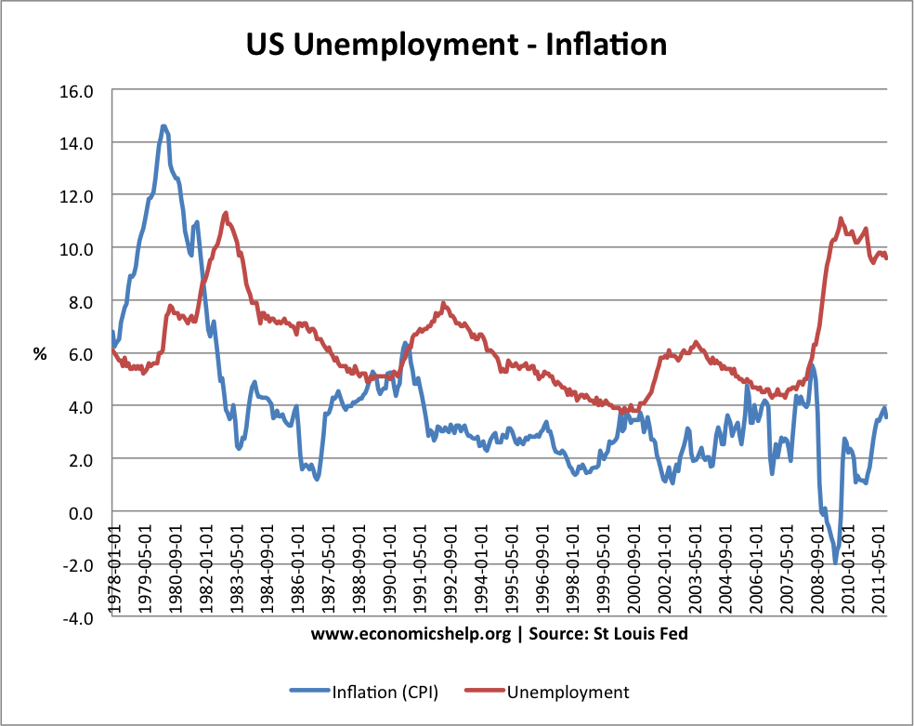
Economics in the 1980s
Recession 1981-82
Iran oil embargo led to increase
interest banks to avoid inflation
10% unemployment
Reagan Tax Cut
Increase defense spending
Boost the economy by allowing corporation to get more money
Allowed growth of economy and brought out of recession
National Debt Increase
Tax cut, defense spending, etc.

Slide 5
Rise of Apple in the 80s
Founded by Steve Jobs and Steve Wozniak
Started in a garage
Built on research from the DoD
Shrink technology/make it affordable
1984- 8.2% of households have a computer
2000- 51% of households have a computer
Aided the growth of the internet
Rise of Technology

Slide 6
National Debt
Tripled from 1981-1989
Increase in defense spending
Huge tax cuts
Social Programs
Inbalance in the budget
Reaganomics
Change to the financial sector

Slide 7
Internet gains popularity
The largest network of networks in the world.
More jobs to internet and changes economy more
Original use - interconnect laboratories in government research
December 1995 - December 1999, the rate of use went from 16 million to 248 million
Geocities, Search engines, Animated Gifs, Realplayer, and AOL.

Slide 8
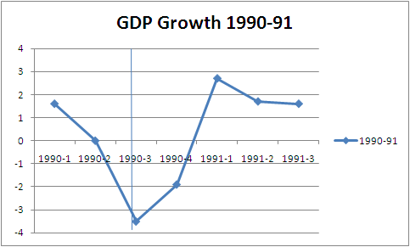
Recession 1990-1991
Savings and Loan Crisis - greatest bank collapse
Debt that corporations and individuals created in the 1980s
Caused bankruptcies
Fear Factor
Black Monday

Slide 9
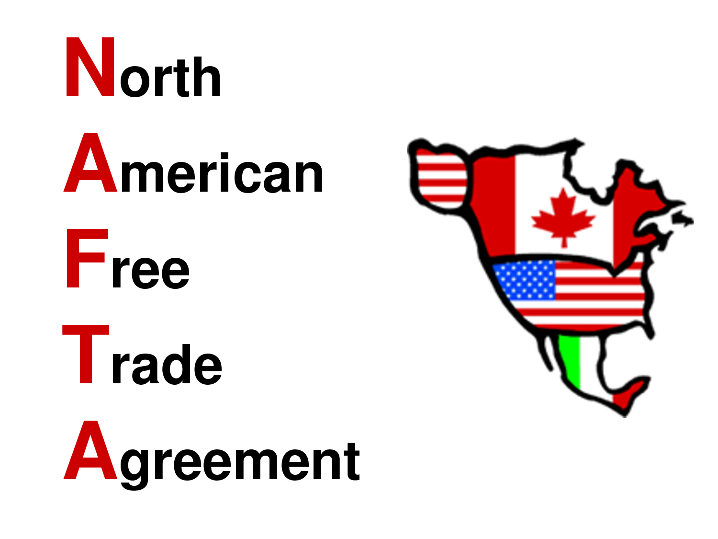
NAFTA Ratified 1993
North American Free Trade Agreement - Got rid of tariffs and other things that decreased trade between the U.S., Canada, and Mexico.
It was designed to give americans more jobs but actually made outsourcing easier for employers.
Indirectly led to increased pollution and almost a depression in Mexico.

Slide 10
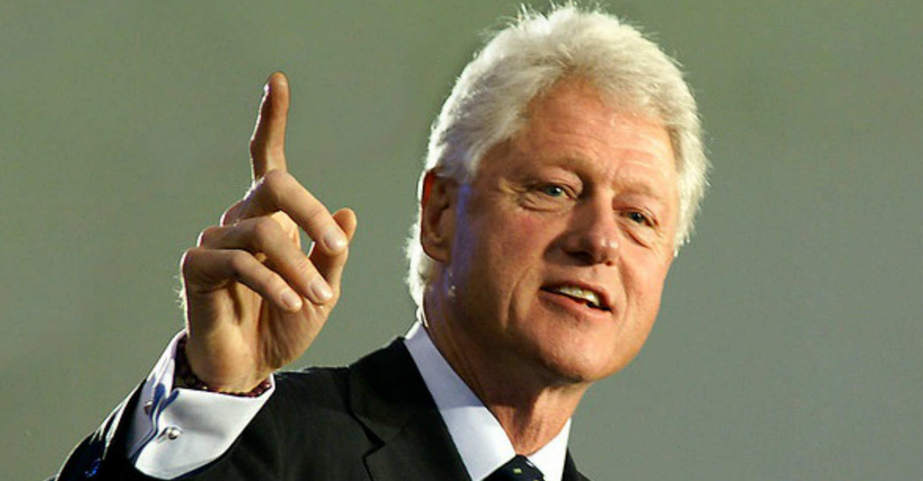
Debt reduction under Bill clinton
Higher tax rates on wealthy
Cut military spending
Growth of surpluses
First four years of presidency - debt rose
Next four years - debt fell

Slide 11
Crisis in Newspaper Industry
Decrease in newspaper sales and popularity
New media outlets like television and internet providing the news
Number of newspaper companies decreased

Slide 12
The Great Recession of 2007-2010
Home mortgage crisis
Housing bubble burst
Securities backed by subprime mortgage → collapse
Default on mortgages
World stocks fall
Stimulus packages passed in attempts to resolve the debt

Slide 13
Bank Bailout (2008)
$700 billion bailout of the financial services industry
buy bad mortgage-related securities, which have slowed and, in some cases, dried up the flow of credit.
Results
committing American taxpayers to permanent, blind support of an ungovernable, unregulatable, hyperconcentrated new financial system that aggravate the greed and inequality that caused the crash
forces Wall Street banks like Goldman Sachs and Citigroup to increase risk rather than reduce it

Slide 14
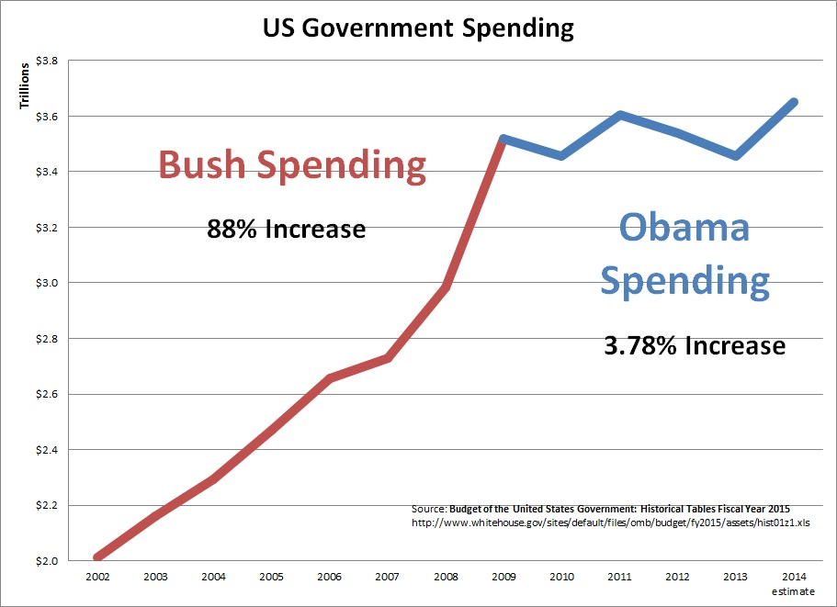

Slide 15
Unemployment hits 10%
Unemployment hit 10.2 percent, the highest rate since 1983
a sign of the continued weakness in the labor market
The jump in the unemployment rate was driven up by a large drop in the number of people who describe themselves as self-employed, as well as the number of teenagers who have jobs
There was a real mismatch between the unemployed people out there compared to what job openings are available,

Slide 17
Financial Sector as % of GDP
By 2014, the financial industry comprised 7.2% of the US GDP and employed 6 million people.
Product of an increase in service jobs and decrease in manufacturing.
The US is managing investments in and from nations around the world.
In theory, a lot of economic growth could come from this. But economic downturns like in 2008 could become more likely, devastating, and global.

Slide 18
Trends
Globalization
As America became service and financially driven in world affairs, America become more reliant on other countries.
Change to the financial sector
America became more economically fragile and service driven due to the decrease in manufacturing.
Rise of technology
Developing technologies brought rapid growth to service and financial industries.

